Slide 1

WELCOME BACK TO
MONEY BASICS
Facilitated by:
[Facilitator 1 name]
[Facilitator 2 name]

Slide 2
Credit & Loans
Workshop 6
PG. 99 IN STUDENT GUIDE

Slide 3
Welcome Back!
Updates & Sharing:
How did the money saving homework go?
How are your budgets going?
Today’s Agenda:
Learn about credit -- how it works, what credit reports and credit scores are, FAQs about credit scores, and common credit card terms.
Discuss the pros and cons of credit, what to do if your credit card is lost or stolen, how to develop healthy credit habits, and how to pay down credit card debt.
Learn about loans – what they are and why someone would take one out, pros and cons, common terms used in loan contracts, and interest rates on loans.
Understand the definition and warning signs of predatory lending, and how to take action to avoid or respond to predatory lenders.

Slide 4
Community Agreements:

Slide 5
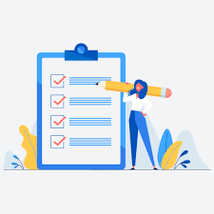
Learning Objectives
Upon conclusion of Workshop 6, participants will:
Have learned the basics of how credit works and understand basic credit terms
Understand the pros and cons of credit
Know how to identify for themselves a comfortable line of credit
Understand the importance of credit reports and credit scores
Have learned effective techniques to pay down credit cards
Understand loans, loan contracts, interest rates, and the pros and cons of taking out a loan
Be able to identify the warning signs of predatory lending

Slide 6
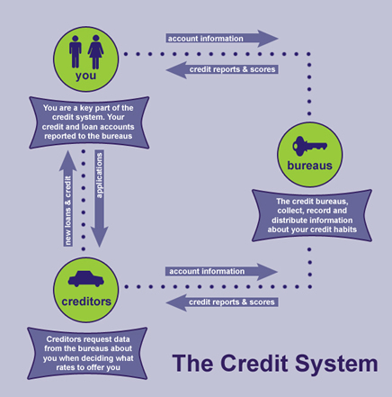
How Credit Works
The Credit System:
Information about your credit card and loan accounts is reported electronically to the three credit bureaus by your creditors every 30 days
These bureaus --TransUnion, Equifax, and Experian -- collect and store your credit information for future reference.
This information makes up your credit report, which is used by potential lenders to determine if you are a risky customer

Slide 7
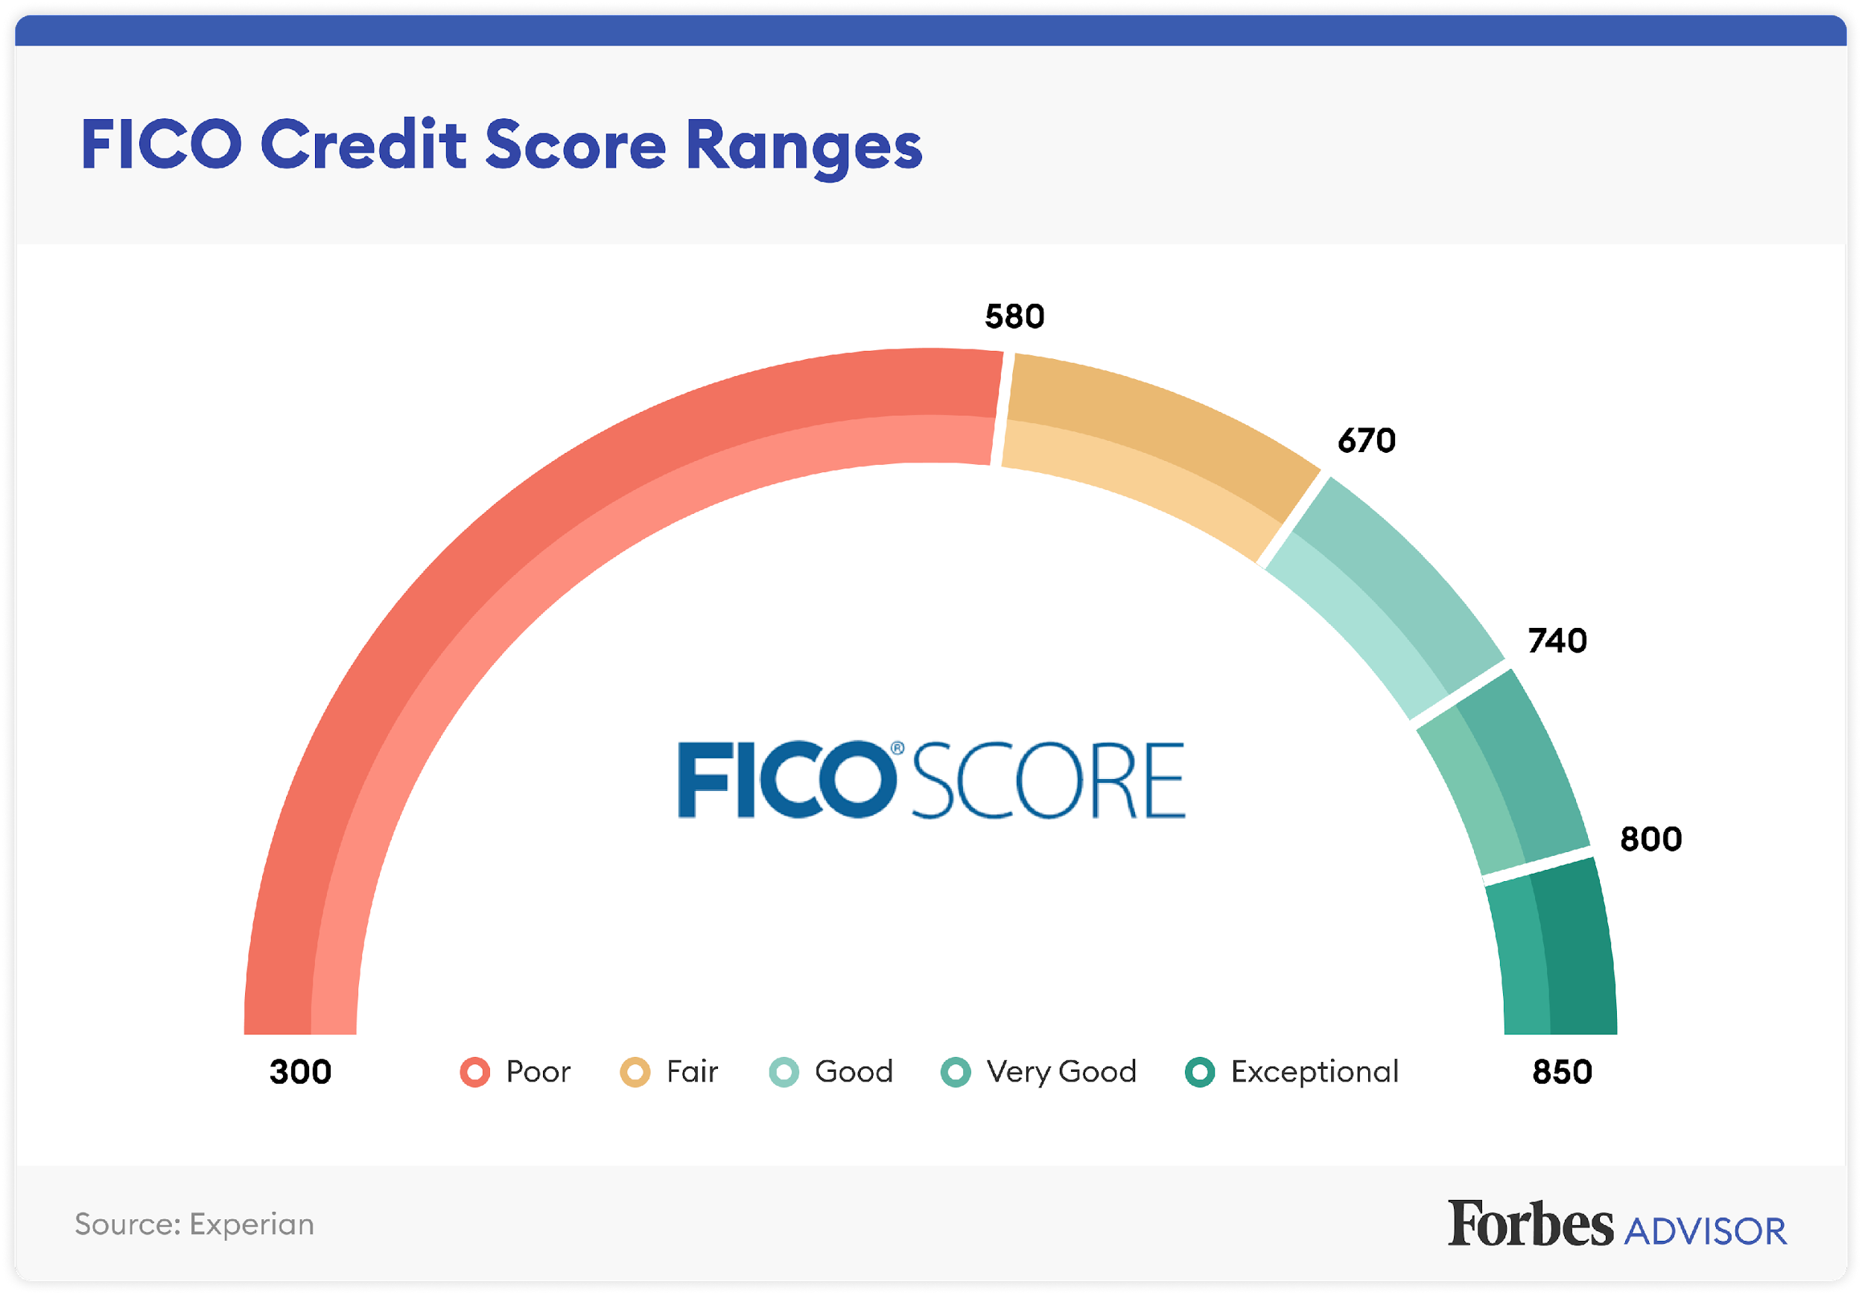
Credit Reports & Credit Scores
Credit Reports: An accumulation of information about how well you pay your credit card bills and repay loans, how much credit you have available, what your monthly debts are, and if you have any bankruptcies or tax liens on record
Credit Scores: A 3-digit score representing the information in your credit reports; indicating how risky a borrower you are from a lender’s perspective
A higher credit score (700+) will get you better interest rates and deals
Best way to have a healthy credit score: use your credit cards and/or loans responsibly and pay on time every month
Discussion: What are some financial activities that would require good credit?

Slide 8
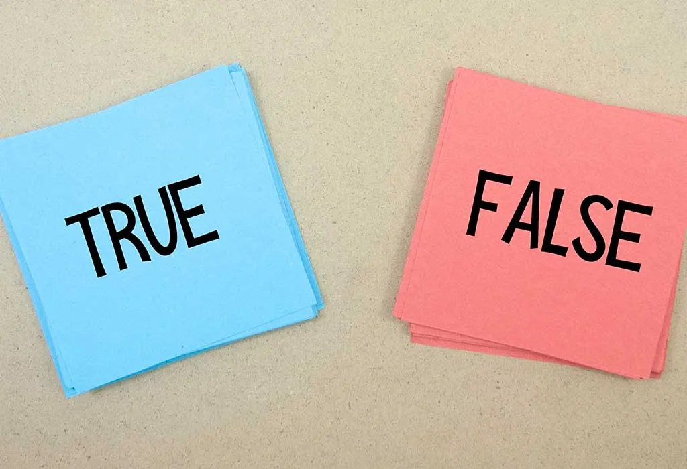
Credit Cards: Fact or Fiction?
True or False?
When a credit card company/bank sets limits on how much can be charged on a card, it’s based on your ability to handle debt
T/F
Late fees, if you don’t pay your bill on time, can be as high as $35
T/F
Usually, the lower your credit score, the higher your credit card interest rates will be
T/F

Slide 9
Credit Cards: Fact or Fiction?
True or False?
4. The grace period for credit cards is usually about 30 days
T/F
5. Secured credit cards can be a good option for someone with poor credit or no credit
T/F
6. If you charge over your limit on a secured credit card, the bank can take the balance from your account
T/F

Slide 10
Credit Cards: Fact or Fiction?
True or False?
7. Making the minimum payments saves you money
T/F
8. If you pay less than the minimum payment, your card will be deactivated
T/F
9. If your credit card is lost or stolen, or has been used without your permission, you will be responsible for only the first $100.00 of unauthorized charges if you report it right away
T/F
10. If you pay your bill in full during the grace period, you won’t have to pay a finance charge on purchases for that bill
T/F

Slide 11
Pros & Cons of Credit
BENEFITS
DRAWBACKS
Security
No-interest grace period
Rewards and rebates
Online management
Credit limits can be too high
Too easy to buy now, pay later
Risk of identity theft

Slide 12
Healthy Credit Habits
Developing healthy credit habits:
Pay your credit card bill on time
Don’t accumulate too much credit card debt
Monitor your credit reports for errors/signs of identity theft
How much credit is too much?
Look at the situations in the Guidebook. Do any of these apply to you?
Steps to paying down credit card debt:
Stop using your credit card(s).
Pay off the card with the highest interest first.
Pay more than the minimum due.

Slide 13
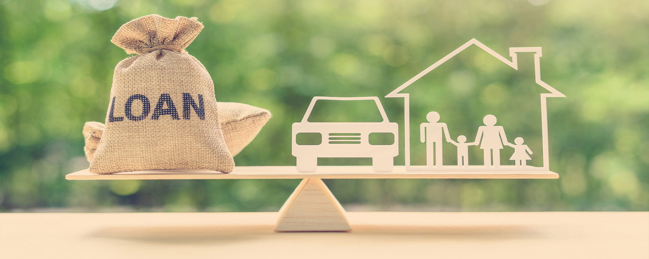
Loans
How do loans work?
A person borrows an initial amount of money (the principal) from a lender (a bank, credit union, or lending company) to pay for a big purchase (such as a car, home, or education) and signs a contract promising to pay this money back in regular installments, plus interest.
What are some reasons a person may take out a loan?

Slide 14
Pros & Cons of Loans
BENEFITS
DRAWBACKS
Gives you the ability to buy something now (like a home or a car) that you could not otherwise afford.
A small business loan or student loans can help you grow professionally and build human capital.
A single, low-interest loan can help you pay off several debts faster and can save you money in interest.
You will pay interest. Over time, you will end up paying more than if you had paid for your purchase in-full.
If you have an unexpected change in your income, you may have difficulties making loan payments.

Slide 15
Understanding Loan Contracts
Principal: The initial amount you borrow.
Term: How long you have to pay off your debt.
Interest: The charge from the lender for using their money.
Fixed rate of interest: interest rates remain the same for the loan term
Variable rate of interest: interest rates change with the market
Split rate of interest: your loan can be split into both types of interest rates, either beginning with one and switching to the other or applying fixed rates to a portion of the principal and variable rates to the other portion.
Calculating interest rates:
Interest rate | Potential annual loan interest | Actual total interest | Actual total loan and interest
9.0% | $900.00 | $4500.00 | $14,500.00
12.0% | $1200.00 | $6000.00 | $16,000.00
15.0% | $1500.00 | $7500.00 | $17,500.00

Slide 16

Predatory Lending
What is Predatory Lending?
Any lending practices that put unfair and deceptive loan terms on borrowers
Take advantage of borrowers’ lack of financial knowledge or situation of financial crisis.
Warning signs:
Excessive loan fees
The lender promises you one type of loan but gives you a different one or tries to make an expensive loan look inexpensive
The lender convinces you to take out a loan you cannot afford
The lender links the loan to your assets (home, car) instead of your income
The lender increases your loan amount at the end of the term without telling you up front

Slide 17

Examples of Predatory Lending
Types of loans that could become predatory:
Payday loans
Pawn shop loans
Title loans
High loan-to-value home equity loans
Advance-free loans

Slide 18
How to Protect Yourself Against Predatory Lending
How to Avoid Predatory Loans:
Shop around for loans.
Calculate your debt-to-income ratio.
Make sure the lender is licensed and reputable.
Ask the lender lots of questions.
Keep you eye out for red flags – signing a waiver, contracts with blank spaces – and don’t sign if there are red flags.
How to Get Out of a Predatory Loan:
Report the lender.
Use your Right to Recession within 3 days of signing
Sue the predatory lender
Refinance the loan

Slide 19

Wrap-Up
Thank you all for your participation today!
Are there any questions?
Homework:
Choose one more money saving idea and commit to it for the week. Keep track of which ideas are going well and which are not.
Commit to using your personalized budget for the next week.
Collect information on interest rates of any personal debt you might have and gather information on any loans you have or are thinking about.

